Slide 1
Developing IT Strategy for Business Value
Chapter 2
© 2017 Prospect Press

Slide 2
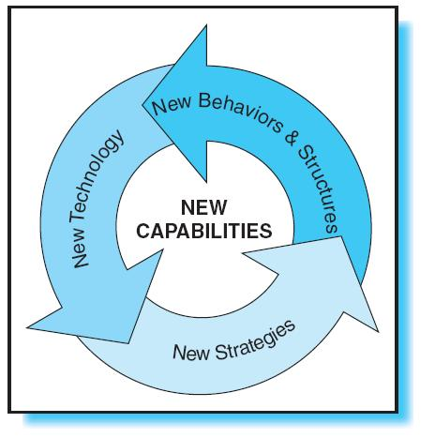
The Importance of IT
New technologies co-evolve with new business strategies and changes to the business environment.
IT and business strategies must be complimentary.

Slide 3
Business and IT Strategies
Historical View – IT strategy should support the business strategy.
IT’s contribution was inhibited by a limited understanding of the business strategy.
IT’s contribution was inhibited by a limited understanding of IT’s potential by the business managers.

Slide 4
Business and IT Strategies (continued)
Current View – IT strategy should be integrated with the business strategy.
IT must be positioned for flexibility, speed and innovation to support rapidly changing business environment.
Technology investments should compliment business strategy.

Slide 5
Business and IT Strategies (continued)
Future View – IT strategy must become more dynamic and focus on developing strategic capabilities that support a variety of changing business objectives.
IT and business alignment will not be point-in-time planning; it will support evolutionary change.

Slide 6
Four Critical Success Factors
Revisit your business model.
Have strategic themes.
Get the right people involved.
Work in partnership with the business.

Slide 7
Revisit Your Business Model
A business model explains how the different pieces of the business fit together.
The business model should be clear and describe the unique value that the organization can deliver.

Slide 8
Have Strategic Themes
IT strategy is about carefully crafted programs that focus on developing specific business capabilities.
IT and business programs that are grouped in strategic themes are easier to track and support interdependencies.

Slide 9
Get the Right People Involved
Senior management should take an active role in IT decision making.
Key stakeholders should be involved in determining technology opportunities.
Some companies have accomplished this through account manager positions.

Slide 10
Work in Partnership with the Business
Business and IT must both have input into the strategy.
IT projects should be synchronized with business objectives.

Slide 11
Dimensions of IT Strategy
Business Improvement – stress relatively low-risk investments with short- to medium-term payback. Focus is on streamlining business processes.

Slide 12
Dimensions of IT Strategy (continued)
Business Enabling – transforms or extends how a company does business.
--Typically focused on revenue growth.
-- Cost-benefit is usually not as
clearly established.

Slide 13
Dimensions of IT Strategy (continued)
Business Opportunities – small-scale experimental initiatives designed to test the viability of new concepts or technologies. High risk projects that typically do not have well-defined, expected returns. These typically have a much lower success rate so funding is sometimes difficult to obtain.

Slide 14
Dimensions of IT Strategy (continued)
Opportunity Leverage – leverages successful experiments or prototypes. Technology is easy to imitate; some initiatives may leverage the results of other companies.

Slide 15
Dimensions of IT Strategy (continued)
Infrastructure – Operating level hardware and software must be maintained. Typically not well understood by business managers.

Slide 16
IT Strategy Development Best Practices
Rolling Planning and Budget Cycles – plans and budgets should be updated more than once per year.
An Enterprise Architecture – consisting of an integrated business and IT blueprint. It should assist in identifying duplicate solutions.

Slide 17
IT Strategy Development Best Practices (continued)
Different Funding Buckets – allocate funding for all five types of IT projects.
Account or Relationship Managers – IT account managers to identify synergies and interdependencies among lines of business and opportunities for technology to improve the business.

Slide 18
IT Strategy Development Best Practices (continued)
A Prioritization Rubric – Adopt multiple approaches to justify project funding decisions to account for the differences in return on IT investment.

Slide 19
Barriers to Effective IT Strategy Development
A governance structure for enterpisewide projects
Enterprisewide funding models
Parallel and linked resources for developing IT and business strategies
Traditional budget cycles

Slide 20
Barriers to Effective IT Strategy Development (continued)
Balancing strategic and tactical initiatives
Skills in strategizing

Slide 21
Conclusion
IT strategy is gaining attention by businesses.
Most organizations are still at the early stages of integrating IT strategy with business strategy.
Balancing IT solutions with business strategy will position organizations to respond to rapidly changing business environments.

Slide 22
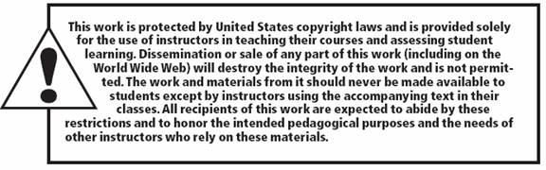
2-22

